Slide 1

2000_euHReka Full Overview
February 2009

Slide 2
Introduction
eWS Document Management – Introduction
Training Objectives
After undergoing this training you should be able to:
Understand the concept of euHReka
Learn the architecture of euHReka and its different components.
Have an overview of the different services that NGA offers by using euHReka
Have an overview about the way the software is deployed and implemented
Identify the different documents associated to the product .
Learn how to get more information from the Intranet.
Prerequisites
You do not need any specific previous technical knowledge to attend to this course.

Slide 3

euHReka, NorthgateArinso’s Global HRIS Solution
Agenda

Slide 5

Leveraging SAP HCM
the concept
euHReka OnDemand – BPO - OnPremise
Deployment layer
euHReka is a comprehensive preconfigured HCM (Human Capital Management) solution, supporting HR, employees, managers, line managers and service center agents:
administer the global workforce
manage talent
provide global & strategic HR reporting
multi-country payroll
powered by SAP HCM
enriched with preconfigured processes
extended with a Web 2.0 UI
deployed OnDemand, BPO or On Premise
fast On Boarding through Fit-Gap
euHReka workspace – scm – ecm
Interaction layer
euHReka core
Preconfiguration & multi-tenancy capabilities
Standard
SAP HCM
Datamodel & Functionality
Notes:
To answer to our customers requirements, NorthgateArinso has developed euHReka
SAP is not as good as euHReka
A preconfigured Human Capital Management (HCM) platform
Multi-country & pre-configured
able to serve more than 50 countries
containing national regulations on payroll and workforce handling
Supporting HR, employees and managers in the organization:
administer the entire workforce
provide global reporting
Serve all countries with euHReka payroll or vendor managed Payroll solutions
manage talent
provide strategic HR reporting
Powered by SAP HCM technology
Delivered as a Service: OnDemand or BPO
On-boarded through a fast fit-gap approach based on standard options and building blocks
1) Standard SAP.
Typical HCM module in which NGA has good experienc.
2) euHReka Core Preconfiguration & multitenancy
Based in best practices from so many years of experience.
Groups / Sugroups / Actions (Hiring, Terminations,..) configured per country (ALCO Project)
Projects are reduced from tipical year to 2-3 months. This is the idea of preconfiguration.
3 levels: Global / Country / Customer levels.
Best is to configure at higest level posible and to inherit the config downwards.
No more need of a BBP. No need of long meetings to gather requirements. We based it in the Fit Gap Analysis
Normally,it requires a lot of effort to decide what a customer can change and how to do it was even a bigger problem.
Multitenancy: Org Units will be seen for all customers in the same client. That cannot be possible
Data model is then enhanced via GCC/LCC to allow multitenancy.
3) eWS
No more need of ESS/MSS as it is replaced.
Front-End Application 0 footprint installation (nothing in your PC)
Intuitive / easy to use.
All kind of roles are supported: EE, MNG, HRADMIN, AGENTS
SCM: Manages the tickets, SLA monitoring, Agents can use eWS to access to the tickets.
4) Deployment Layer
BPO we did it in the past: GM with no euHReka but know we do not sell with no euHReka. We did everithing.
On-Demand: SaaS solution. The application is hosted by NGA but the customer run their own processess.
An EoD customer can decide to outsource the Payroll, for example, Cost Saving becuase we are cheaper
EoP: Available in April 2011. We give eWS to a customer to be installed by themselve. They do not get the 2nd layer. GCC/LCC do not exist (GCC=LCC=Blank) 99EHR Parameter = YES means euHReka system and NO= it is a EoP system.
Qualification Premiun to make sure eWS follows the same quality standards than SAP and SAP is reselling eWS as an Add-On instead of ESS/MSS (they did not sell licenses in USA)
We need to still solve some accesibility issues (blind, no mouse,...), needed mainly to Public Sector in the US
ECM/SCM is partially delivered in EoP because the Java Stack is not activated in our customers.
There diffenrences between functionality SAP and EOP which works in both ways

Slide 6

euHReka preconfiguration
the concept
Customer Requirements
Customer
Requirements
euHReka
standard
SAP HCM
parameter driven
preconfiguration
Common requirements: 80% covered
PRECONFIGURED Process & workflows
PRECONFIGURED Rules & regulations
standard SAP HCM
Common requirements: 20% covered
PRECONFIGURED Global template
PRECONFIGURED Functional building blocks
Notes:
In a Classical project: 80% customizing and Development
Standard SAP barely offers more than the basics , I.E. Gross-to-Net for payroll and requires quite some configuration efforts
Based on our extensive experience in implementing SAP HCM, we have pre-configured SAP HCM
euHreka offers preconfigured processes that cover about 80% of typical customer requirements.
euHReka has been built to offer the best of both worlds: standardization + flexibility
Standard HCM will typically cover 20% having 80% still to do.
With euHReka we reverse this rule. You start a project with a 20% already done.
Global Template: Best practices in EG/ESG/Personal Actions
Processess included in euHReka (will see the box) until L3 based on best practices
Flexflow: preconfigured workflows via small tables: Time it takes an approval before escalation
Functional Building blocks: Pieces of coding for eWS (Framework) or backend (AFI):

Slide 7
Preconfiguration example: payroll
the concept
Classic payroll:
Carefully define every step from scratch
euHReka payroll:
Swiftly select from preconfigured options
Requirements analysis
Step1: Read Data
Option 1: Read Data
Option 1: Read Data
Evaluate options > get alignment > legal check > > get approval > implement custom process
Requirements analysis
Option 2 A
Step 2: Absence Valuation
Option 2 A
Option 2 B
Option 2 C
Option 2 D
Evaluate options > get alignment > legal check > > get approval > implement custom process
Requirements analysis
Option 3 A
Option 3 B
Step 3: Overtime Valuation
Option 3 B
Option 3 C
Option 3 D
Evaluate options > get alignment > legal check > > get approval > implement custom process
Requirements analysis
Step 4: Premium Valuation
Option 4 A
Option 4 A
Option 4 B
Option 4 C
Evaluate options > get alignment > legal check > > get approval > implement custom process
Requirements analysis
Option 5 A
Step 5: Gross Valuation
Option 5 A
Option 5 B
Evaluate options > get alignment > legal check > > get approval > implement custom process
Requirements analysis
Step 6: Net Calculation
Option 6: Net Calculation
Option 6: Net Calculation
Notes:
Let’s illustrate how preconfiguration works, through this payroll example (talent management examples will be published later):
NorthgateArinso has analyzed country by country the different rules constituting various enabling HR processes, such as gross and net payroll.
All options are preconfigured and can be switch them via parameters
As an example:
3 ways of calculating overtime, we have analyzed those 3 ways and customized them in the euHReka platform. In euHReka, options are pre-configured and set by parameters allowing customer specific process organization.
euHReka contains utilities and mechanisms to facilitate the implementations-> Go to “Effects of the AFI Tool on Payroll euHReka”
No preconfigured rules for Time Management
ALCO: Alignment Localization and Compliance ensurance.

Slide 8
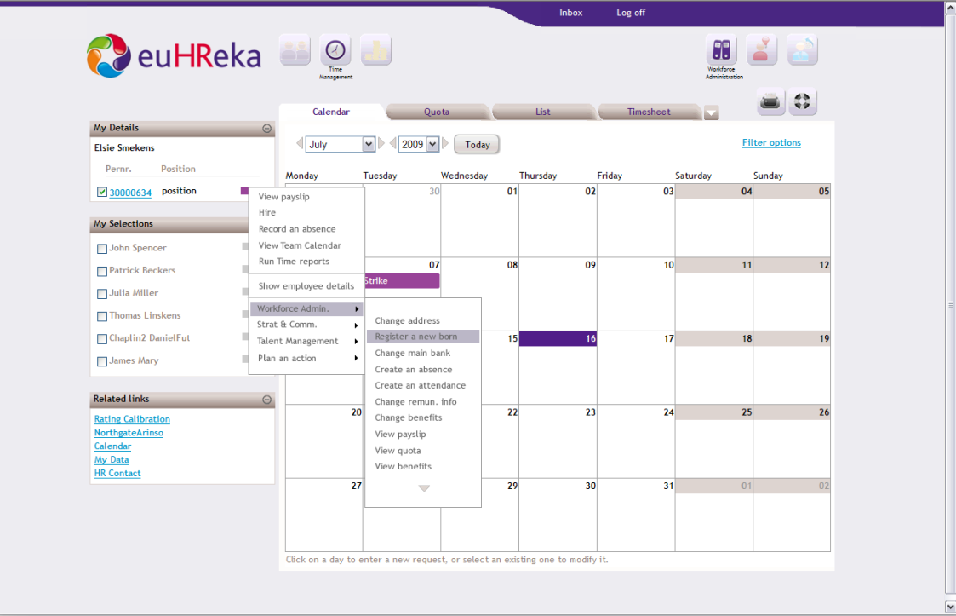
Superior User Experience
the concept
100% browser-based
User-friendly, Google-style, intuitive user interface
User interaction researched by academics
Fast response time and dynamic interaction (AJAX)
Less navigation needed through role- and context-based structure
Integration with service center support and knowledge tools
Integration of system and HR information
Copyright NorthgateArinso. All rights reserved.
Notes:
This is what employees today require, many from Generation X or Y.
Employees have grown up with games, mobile phones, the internet, chat, etc. As a result, they want to do their HR transactions in a flexible yet reliable way.
euHReka combines a cool front-end with a solid back-end.
Customer does not need to install anything. Browsers: IE, FF, Safari, Chrome being FF the best (avoid IE6: some security issues)
The user experience is fast, requires less clicks, is Web 2.0 proof, Google alike.
Namahn helps to design good digital products or services from a human perspective.
AJAX: Asynchronous Java and XML. Parallel processing.
Principle of What you see is what you do (contextual actions) based on Role & context based structure. A Manager will be more actions than the employee but less that the administrator. All these in configured in backend tables where the actions and Appid are linked to roles. Tipical ESS/MSS will tell you if you are authorized to do it afterwards.
Integration with SCM. Agents can see HRW through eWS.

Slide 9

euHReka Workspace
the concept
Contextual Help retrieved from KM
Contextual Navigation & Selection within euHReka workspace
Contextual Info retrieved from KM
Data from
euHReka core
euHReka ecm
euHReka sct (HRW)
Contextual Actions
euHReka Workspace
Notes:
This is how it looks. Incoming EFR 206 is bringing new features but this is basically the format.
Each icon has a logo which resembles the big functionality inthe logo of euHReka.
Dark blue if WFA
Red Talent Management
Light Blue Strategy and communication
Orange Reporting and Analytics
Secondary Icons: WFA leads to Time, Personal Data, Benefits: This cannot be modified at customer level.
Then little tabs that can be created by customer.
Left Menu: My details, My Selections and Related Links (contextual info from ECM but standard is empty and needs to be filled by Customer with policies, processes, …
My selection can contain check boxes or radio bottom, depending on the application. Multiple selection will be recognized by different colors. Evaluation Paths are the way to calculate the objects (in this case people) that can be accessed by the user.
Contractor can be done via External subgroup or External Object (H)
There is a new functionality: Advance Search where you can search based on information stored in certain infotypes like (IT1, IT2, IT8, …)
There is a pagination feature. Allows upload only 20 ee. No scroll bar needed.
Contextual action plays an important role depending on who you select.

Slide 10
Flexible Role Composition (example for Succession Planning)
Succession
Planner
...
Employee
Manager
Succession Dashboard
Identification of key positions
Assess resourcing risks
Create Succession Plan
Execute Actions
Fill questionnaires
View on Career plan
Creation of questionnaires
Talent Relationship Management
Add external candidate
....
Customizable
Notes:
Roles in euHReka are composed by authorizations on a Application level, euHReka has been build as a very modular solution allowing to define roles as flexibly as the customer wants.
Of course euHReka comes with a set of “best-practice” roles defined, but any can be added altered
Functionality which is part of the application that are linked to AppId.
The exercise is to assign Roles to functions.
Example for Succession planning:

Slide 11


Flexible deployment options
the concept
OnPremise
Add On Product for SAP HC
BPO
Platform
OnDemand
Platform
euHReka workspace
parameter layer
euHReka workspace
parameter layer
euHReka workspace
parameter layer
euHReka workspace
development & customising
euHReka workspace
development & customising
euHReka workspace
development & customising
Customer-specific
development & customising
Customer-specific
development & customising
Customer-specific
development & customising
Templated layer
euHReka
global template
Core parameter layer
Core parameter layer
Core development & customizing
euHReka
Notes:
- BPO: both technology & process are outsourced; NorthgateArinso assumes responsibility over the result (quality & timeliness of HR transactions) Originally, euHReka has been set up as a multi-tenant, multi-country BPO solution.
Thansk to its preconfigured settings, it can now also be set up as an OnDemand solution, or as OnPremise templates.
- BPO: SAP HCM+Core Dev(Bulding Blocks)+Backed euHReka Parameters + Customer Specific + eWS Dev +eWSParameters
OnPremise (in-house solution): no outsourcing, both technology & process remain in-house, but implementation can be accellerated by applying pre-filled templates
EoP: SAP HCM + euHReka Global Template (just best practice on objects that are SAP standard) + Customer Specific + eWS Dev +eWS Parameters
euHReka as a name cannot be used but instead HR Workspace by NGA. (it is too related with ARINSO)
EOP Gold?
OnDemand:Only technology is outsourced, process is owned by customer; NorthgateArinso assumes responsibility over the technology delivery (uptime, availability, etc.)
EoD: We do not customized for customer only using templates. We try to use the software out of the box as much as possible.

Slide 12
euHReka deployment options
the concept
BPO: outsourcing technology & process
OnDemand: outsourcing technology only
Enabling processes
Talent management
Payroll
Personnel administration
Organisational
mgmt
Time &
attendance
Recruitment
Learning &
Development
Performance
Management
Succession
Planning
Compensation
& Reward
Self Service
T0
euHReka Workspace
Service Center Agent
T1
Comprehensive BPO
Comprehensive
OnDemand – Processing (2nd Level support)
2nd Level support
Managed Service
Subject Matter Expert
T2
Managed
Technical Expert
AMO
OnDemand – Processing
Processing
Infrastructure & Network Engineer
ISO
Notes:
Deployed on-premise, hosted, accessed via OnDemand or fully outsourced, euHReka can meet your individual needs. Customers can pick and choose the capabilities they want – by process, by country, by organizational business unit - and change/enhance choices as the business requires.
euHReka is 1 platform, the difference between EOD & BPO is only a matter of difference in service offering.
EOD is only services around the software provisioning, which commonly is called SaaS (Software as a Service)
BPO add HR Services on top of the software platform, from managed Services (Tier 2 agents) to comprehensive BPO (Tier 1 & Tier 2 agents)
Processes:
Enabling processes: Transactional processes mainly WFA
Talent Management: Added Value processes
Tiers:
0: No Human interaction. Self Service: Example is to see the payslip or vacantion days: 60% of queries
1 Pick-up the phone and answer basic questions like how can I see my Personal Data. 30% of queries
2 Escalation for more difficult questions like Why I have more salaries? Because you have less taxes. 5% of Queries
AMO and ISO
Solutions
For Processing Services: We use EoD: Host the application and keep it legal compliant + Second Level Support to be defined in the SoW (little T1 and little T2).
For Managed Services: We add all T2 support and a bit of Tier 1.
For Comprehensive. We add data entry, which is the remaining Data Entry. No T2f or Talent Management

Slide 13
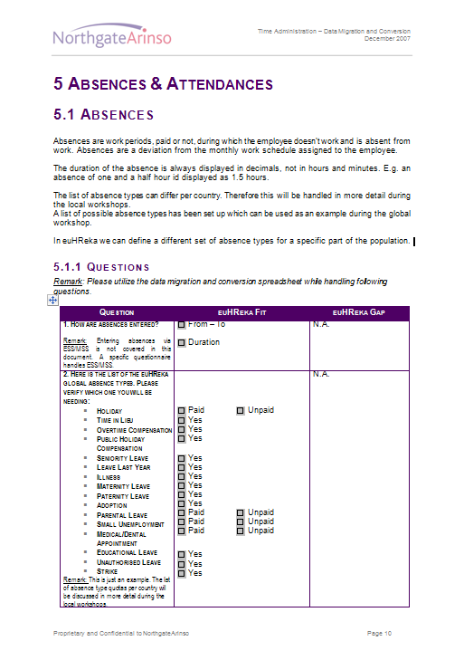
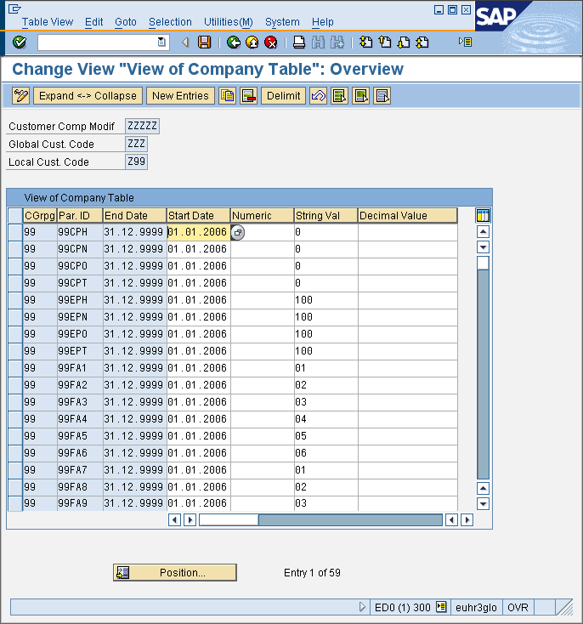
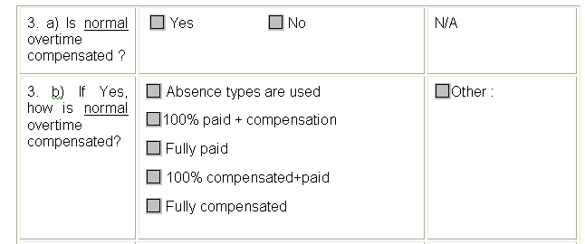

Fast onboarding through ‘fit-gap’
the concept
Fit-gap methodology
Standard questionnaires, not open questions
Best-practice based
Drives standardisation
Reduces implementation complexity
Increases implementation speed
Notes:
The pre-configured options are translated 1on1 to our fit-gap questionnaires, that contain mainly closed questions, options translate immediately to parameters in euHReka
No Open question but parameter driven questions.
There are 4 ways to calculate Overtime
Composition of other Wage Types
Compensate on time
Combination of above
Others => There is Gap.

Slide 14
euHReka global pre-configuration availability
the concept
Non euHReka or Non SAP supported payrolls will be supported through our 3rd party payroll provider BDO ltd.
euHReka Only country availability
euHReka + SAP country availability
SAP Only country availability
Luxemburg
Morocco
UAE
Argentina
Australia
Austria
Belgium
Brazil
Canada
Chech Republic
China
Denmark
Finland
France
Germany
Great Britain
Hong Kong
Hungary
India
Ireland
Italy
Japan
Mexico
Netherlands
New Zealand
Poland
Portugal
Russia
Singapore
Slovakia
South Africa
Spain
Sweden
Switzerland
Taiwan
USA
Bulgaria
Indonesia
Malaysia
Philippines
Saudi Arabia
Slovenia
South Korea
Thailand
Turkey
Notes:
euHReka is available in 40 countries around the world.
Some are delivered by SAP and are pre-configured by NGA on euHReka (40),
Some only available as SAP solution on euHReka, so not yet pre-configured but usable as in a normal sap project on euHReka
Some are available only on euHReka as SAP does not support these localizations
Which countries we have a solution?
ALCO Project:
Level 1: All standard SAP workbench objects and configuration is made compliant with euHReka conventions and all euHReka tools (AFI, RevTrac, NRV, CEX) are installed. Functionality is the same as SAP standard.
Level 2: Level 1 plus PA, PT and Gross Payroll are pre-configured. Added value with a euHReka project and the objective is met to reduce on-boarding and AMO time
Level 3 (Ews): All local master data entry functionalities within workforce administration delivered within euHReka Workspace.
There is no SAP solution for LX (no payroll driver) but we do have a soluition.
Other countries where SAP is the only solution as we do not have a solution. Example Turkey where I think there is a Add-On solution.
BDO:
We have an agreement WW with BDO for countries where there is no ee enough (no business case) or there is no solution.

Slide 15
euHReka global language availability
the concept
SAP
Available
Languages
euHReka
Installed
Languages
EWS
Installed
Languages
 | SAP Available languages | Installed Languages backend | Available today in EWS
1 | Afrikaans
2 | Arabic
3 | Bulgarian | 1
4 | Catalan
5 | Chinese | 1
6 | Chinese trad. | 1
7 | Croatian
8 | Customer reserve
9 | Czech | 1
10 | Danish | 1
11 | Dutch | 1 | 1
12 | English | 1 | 1
13 | Estonian
14 | Finnish | 1 | 1
15 | French | 1 | 1
16 | German | 1 | 1
17 | Greek
18 | Hebrew
19 | Hungarian | 1
20 | Icelandic
21 | Indonesian
22 | Italian | 1 | 1
23 | Japanese | 1
24 | Korean | 1
25 | Latvian
26 | Lithuanian
27 | Malaysian
28 | Norwegian | 1
29 | Polish | 1
30 | Portuguese | 1 | 1
31 | Romanian | 1
32 | Russian | 1
33 | Serbian
34 | Serbian (Latin)
35 | Slovakian | 1
36 | Slovenian
37 | Spanish | 1 | 1
38 | Swedish | 1 | 1
39 | Thai | 1
40 | Turkish | 1
41 | Ukrainian
 |  | 24 | 9
Additional languages are installed on an ongoing basis
Notes:
On euHReka hcm there are 24 languages available which gradually are made available to the euHReka workspace, today 9 languages are available on the euHReka workspace, more to be added in next 2 releases
Language is different than countries. No different flavors of French or English are supported
You can log in SAP in those language but if the language is not available in euHReka, we need to upload and install in our system to make it available in the euHReka Global Template (for example Actions or WT names)
You cannot sell a language not in left column.
For eWS installed language: Japanese has not been translated in eWS. All Global customers (like AZ) will need to have those languages.

Slide 16




A tool for every task
the concept
NEW !
Supports all HR Roles: employee, manager, service center agent, business partner
Accessible through a single web-based user interface
Spans all HR Processes:
Strategy & Communication
Workforce Administration
Recruitment & Staffing
Talent Management
Analytical Insight
Embeds Contextual Enterprise Content
Document Management
Knowledge Management
Embeds Service Center Management tools
= the former HRW backbone brought to EWS
(Front-end)
Since
2003
^{hcm}
(Back-end)
Since
2006
^{ecm}
Since
2003
(Back-end)
^{scm}
(Back-end)
Notes:
How mature is your product? euHReka is there since 2003.
euHReka consists of 4 components, 1 Front-end (=userinterface) component which we call euHReka workspace, the UI sits on top of 3 back-end components:
euHReka hcm = the SAP based pre-configured HR component, contains pre-configuration for 40 countries in different levels , and pre-configuration for all talent management processes.
euHReka ecm = our document and knowledge management back-bone (used to be based on Documentum, now is our own IP)
euHReka scm = our Service Center Management component (is nothing else than the backbone we used to call HRW, but now accessible through the euHReka workspace UI)
IMPORTANT MESSAGE:
Only the euHReka workspace, the Front-end is new, all the rest is in use since many years at NGA, both internally as externally with customers

Slide 17

euHReka, On Demand Defined
the concept
euHReka = the only Integrated Global ON-DEMAND HR-Service Platform
Workforce Administration
Employee Interaction
Employee Data
Time Management
Payroll
Benefits
Health & Safety
Mobility
Recruiting & Staffing
Manage Requisition
Manage Applications
Manage Applicant Pool
Talent Management
Performance Management
Succession
Train & Develop
Compensation
Strategy & Communication
Organizational Development
Workforce Planning
Labour relations
Employee Communication Portal
Time Management Options
Negative Time Management
Positive Time Management
Time Sheet
...
Payroll Options
Print Payslip
Envelop Payslip
Distribute Payslip
...
Manage Requisitions Options
Monster JobBoard
JOBAT Jobboard
...
Performance Management Options
Hay Job Evaluation
...
Learning & Development Options
Skillsoft Learning
...
BPO
SaaS
On Premise
Service Provider
Fee / Employee / Month
AND / OR
Subscription Fee + Fee / Transaction
AND / OR
License Fee + Maintenance Fee / Year
Notes:
This all leads to the first real On Demand HR solution,
Customers can choose which processes are supported, either as a software service, as a BPO service or on premise,
Choosing from the various options assembling a truly unique solution that meets the needs of a specific customer
That translates in a fee per employee, a fee per transaction or a fee per user, depending on the delivery mode chosen
Key Message:
It is a Standard platform or solution, with many options to be chosen from in order to meet your requirements
You select from the menu, and you pay what you select.

Slide 19








euHReka solution components
the components
Players
Presentation layer
Business logic & content
Content & service providers
Business players
Employee
Manager
Inclusion Framework
HR Administrator
HR Business Partner
Business View
Service Center players
Service Manager
Subject Matter Expert – Tier 2
3rd parties
Service Center Agent – Tier 1
Service Center View
Notes:
Division of roles.
These are examples of roles included in euHReka. Each application has each own Administration Roles (Performance ,Training, OM,..)
Role Determination is done via OM thanks to relationships between objects. For example:
008 Belong to
012 Manages
For more roles
Same concept is used to identify the euHReka Roles
Target object might not be not an Org Unit but for example a Course Catalogue and the owner of the relationship becomes then in a Training Administrator.
Very powerful tool as I can give different accesses depending on the target object
HR Business Partner can access everything but only in Display mode
With no OM, no euHReka now. In the future we can set a more crappy solution via IT105 so that you have your manager name in that infotype. Problems if your manager changes.
Roles predefined in euHReka but you can define your own roles but needs to be valid for the NRV.
Create a new relationship
Create evaluation path assigned to this new relationship and assigned to the new role.
Link all AppID likely to be used by this to new role to the new role.
Presentation Layer:
No Business Logic as it draws the information in the nice manner.
Business Logic:
We have the 3 components included in the Inclusion Framework
IF Allows interactions between the different components and also allows standard interfaces with customers.
Content and Service providers:
The customer does not notice from where the information comes from.
Rewards (Northgate Company) that evaluates Jobs,
Resource Link (UK and US)
Job Boards,
Benefit Providers (in the US)
e-Training content providers (SkillSoft)…
BDO (done using another solution)
PU12 produces deltas but goes SAP/XI is transformed into XML or IDOCs or flat files
BDO are managing solutions even in excel sheets so it is too complex.
We are using DCTS to do it.

Slide 20
euHReka Layered Architecture
the components
euHReka workspace
AJAX Layer
(Views/Flavors)
Employee View
Manager View
Business Partner View
Tier1
Agent
View
Tier 2
Agent
View
Authoring View
(wysiwyg edit)
Admin
View
euHReka Business Logic & User Management
euHReka Platform Layer
Java Stack
Config Engine
Authorization and Roles Engine
ABAP Stack
BL
Config & Param.
Tables
BL
euHReka Process Integration Layer
euHReka Inclusion Framework Layer
euHReka Abstraction Layer
3rd Party/ Customer Abstraction Layer
euHReka ecm
euHReka hcm
euHReka scm
Resource
Link
Customer Integration
3rd Party Solution
ecm
Storage Layer
SAP HCM Layer
.NET Layer
Mail, Fax, Phone, Paper Form
euHReka HCM
Engine
HRW
Engine
Notes:
AJAX Layer
It is the eWS Front-End
Diferent Views already discussed
euHReka Platform Layer = euHReka eWS IMG
Java Stack for BPO and EoD not for EoP
Configuration Engine
200 eWSTables
Authorizations and Roles Engine
ABAP Stack
euHReka Abstraction Layer
Definitions of fieldsets linking Front-end fields with backend engines
Comminucating with the Inclusion Framework
Inclusion Framework
euHReka HCM Engine = euHReka 2.0 IMG
400 in euHReka Core

Slide 22
euHReka Landscape
System Landscape
Build
euHReka
DEV
Release +1
euHReka
TEST
Release +1
REFRESH
euHReka Product Systems
Support
euHReka
MAINTAIN
Current Release
euHReka
TEST + Deliver
Current Release
euHReka
Customer Landscape
DEV → TST → PRD
Customer Systems
2 X 2 Tier Product Development Landscape
Build new core solution (DEV Release + 1)
Refresh Test system with current release and add new Core Solution to regression and integration test.
Maintain current release + develop & maintain country solutions
Regression Test maintenance & Deliver to customers
MSI & CSI concept remains in new System Setup, better split between new and current release.
Copyright NorthgateArinso. All rights reserved. 22
Notes:
Conceptual slide to explain the concept. Next slides get into more detail.
5 Environments approach.
Shared:
Deployment is forced into this landscape for all customers
Shared should be promoted
Dedicated:
Flexibility but get not up to date.
Only a dedicated Production and Test
Development system is shared for all of them.
Shared vs Dedicated
Deviating from ISO standards
Number of Ees
EoP:
To be downloaded form the Service Market Place
CEX:
Extract all configuration (99 and country) mixed in ETC-300 to located in a dedicated client.
It should represent 80% of the work to be done.
Only deltas are sent.
In production should be acompanied with the regresion testing
Change in Italy should no lead to a Regresion Testing in the US
Demo System and dedicated systems for Training (and Sandbox)

Slide 23
euHReka Landscape
euHReka Product Systems
Customer Systems
System Landscape
Release +1
Build
euHReka EDN
euHReka ETN
euHReka customer landscape maintained by Global AMO
Tower
Tower
Dedicated euHReka
200 – Test
Tower
Tower
Tower
DEV ZZZ
QAS ZZZ
PRD ZZZ
300 – Global
300 – Global
Shared euHReka
euHReka ED5
euHReka ETn
euHReka EPn
Tower
Tower
Tower
6 Months
ED5 XXX
ET5 XXX
EP5 XXX
EFR
ED5 YYY
ET6 ET7
EP6 EP7
Current Release
Support
euHReka EDC
euHReka ETC
Tower
Tower
euHReka EE5
100 – CUA
Monthly
200 – Test
ED5 XXX
300 – Global
EMR
300 – Global
ED5 YYY
3x1 Country x1
CEX
AMO Triage Quality Check
euHReka EQC
4xn Country xn
Tower
6zz – Cust ZZZ
EQC 300
6xx – Cust XXX
6nn – Cust EQC
euHReka Demo
euHReka EDM
Tower
euHReka EDS
P1 Emergency FIX
Tower
635 – Cust ZD1
Demo M
Demo S
BUG FIX Transport
EOP DEV
EOP TST
euHReka On Premise
EFR 2.05 / ECC 6.04
D00 EOP
T00 EOP
Processed by euHReka Operations
EFR 2.06 / ECC 6.04
Processed by Global AMO Deployment Team
D01 EOP
T01 EOP
EFR n.nn / ECC n.nn
Processed by euHReka EOP Maintenance
Dnn EOP
Tnn EOP
Copyright NorthgateArinso. All rights reserved. 23
Notes:
Doubled Products enviroments
One Build Relase+1
Other to mantain Release
Double mantenance of bugs
EFR is Functional Release (2/year)
EMR is Maintenance Release (1/month
EQC is to do the Intake and reproduce bugs
We use the concept of Towers, a tower is a SAP ECC HCM system linked with different other systems needed to support our euHReka Solution (e.g. BW, BO, Java Stack, PI).
New release will be developed on EDN and tested on ETN. A release is build during an EFR (euHReka Function Release) in a time frame of about 6 months. For each of the product streams a specific Rev Track will be created to link the transports of the new EFR release.
ETN is a copy of ETC which will be refreshed 1 month before delivery of EFR (copy after latest EMR on ETC).
EDC is for bug fixing current release and for country developments (Alco). Reason why Alco is not developed in EDN is because the frequency of delivery an EFR is much to Slow for Alco solutions since they have a lot of new countries going live and they need to deliver new functionalities and solutions related to legal changes. Every month an EMR (euHReka Maintenance Release) will be scheduled and moved to ETC. For every EMR two specific Rev Tracks will be created so all developers/maintenance team can add bug fixes (transport requests) to the current EMR release. 1 for Customizing (Client dependant changes) and 1 for Workbench (Client independent changes).
Before releasing the new EMR to the customers, the product testing team will do regression testing in ETC200. Development/maintenance with input from the testing team will fix blocking regression issues and will decide on the Go/No Go of the release. A No Go is always a delay in delivery not a cancellation of the actual release.
ETC is delivery system to customers which is done with the CEX (Configuration Extractor) in 3 steps.
Cascade → the CEX will check all customer selected function points (to each function point all related objects are linked) and will update a table to provide a list with all needed objects for delivery.
Update → the CSI Client (each customer has a dedicated SAP client in ETC) the listed objects will be updated with the latest object values from the EMR release.
Export → a transport is generated in the CSI client with all objects and the new values.
This process of Cascade, Update and Export should only be triggered at the moment the customer is also planning to import the transport into their customer systems (DEV,TST,PRD). The transport is a release transport request with fixed/frozen values (picture). When several of these prepared release are not processed, there is a risk of processing them in the wrong order impacting you customer system with wrong values.
The Customizing transports will be imported by the customer teams (AMO/SI) themselves by approving the Rev Tracs and this only after the Workbench on a shared platform has been moved by a central team in line with the release calendar. Currently euHReka Support, soon the Global Deployment Team (AMO).
EE5 is copy from ED5, taken before release update (monthly) and used as emergency delivery system to EPn during Release update process (EMR/EFR)
EQC is the reference system for the Triage Team to validate product issues. This system will also be used to validate new release before they are imported in the shared customer development System.
Dnn & Tnn systems are the different maintenance and delivery systems needed for EOP, every EFR/ECC release combination will require a dedicated system street (e.g. D01/T01). Only every 2 EFR’s an EOP delivery will be done (2.06, 2.08, 2.10,…). Transports will be compiled in SAR files via AAK (Add-on Assembly Kit) tool of SAP, customers can use solution manager to download updates/releases.

Slide 24
euHReka On Premise
euHReka Product Systems
Y<ISO Code>UI
EOP Systems
/EOP/
System Landscape
Release +1
Build
euHReka EDN
euHReka ETN
Tower
Tower
euHReka
euHReka
EFR2.05
ECC6.04
ASAP
D00 EOP
T00 EOP
200 – Test
300 – Global
300 – Global
euHReka
euHReka
EFR2.06
ECC6.04
Jan 2011
D01 EOP
T01 EOP
euHReka
euHReka
EFR2.06
ECC6.05
April 2011
6 Months
D02 EOP
T02 EOP
EFR
Current Release
Support
euHReka EDC
euHReka ETC
euHReka
EFR2.08
ECC6.05
Jan 2012
Tower
Tower
euHReka
D03 EOP
T03 EOP
100 – CUA
Monthly
200 – Test
300 – Global
EMR
300 – Global
euHReka
euHReka
EFR2.08
ECC6.06
July 2012
3x1 Country x1
CEX
D04 EOP
T04 EOP
4xn Country xn
6zz – Cust ZZZ
euHReka
euHReka
EFR2.10
ECC6.06
Jan 2013
6xx – Cust XXX
D05 EOP
T05 EOP
6nn – Cust EQC
euHReka
euHReka
EFR n.nn
ECC n.nn
Month 20nn
635 – Cust ZD1
Dnn EOP
Tnn EOP
euHReka On Premise
Processed by euHReka Operations
Initial delivery via CEX (transport extraction)
Manual maintenance by euHReka EOP Maintenance team
Customer delivery via SAR-file compiled by AAK
Copyright NorthgateArinso. All rights reserved. 24
Notes:
Concept of System Street
Dev + Test (PRD is in customer side)
Reflects the Combination of EFR Release and SAP Release (EFR206 with ECC 6.05) (Only even EFRs will be considered)
Bugs are fixed manually because the version of software are different and cannot be automated
Enhance Packages are accepted to open a newstreet but not for SAP Support Packages
We will ask customers to be at the latest Support Packege available.
EoP streets will be manually updated with bug fixings (no EMRs, no EFRs)
Reserved namespace
There is a convention for all objects in standard euHReka (starting with Yxx being xx = Country or GL)
Overwriting names in our EoP customer could be posible
To avoid this, we have reserved the name space /EOP/ (forward slash) and nobody in the world can use this namespace
We could have swichted to this namespace in all euHReka standard but we only did it in the development system of the EoP so that we avoid regresion issues in our existing EoD customers.
Dnn & Tnn systems are the different maintenance and delivery systems needed for EOP, every EFR/ECC release combination will require a dedicated system street (e.g. D01/T01).
Only every 2 EFR’s an EOP delivery will be done (2.06, 2.08, 2.10,…). Transports will be compiled in SAR files via AAK tool of SAP, customers can use solution manager to download updates/releases.

Slide 25
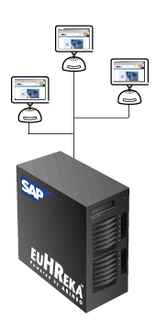
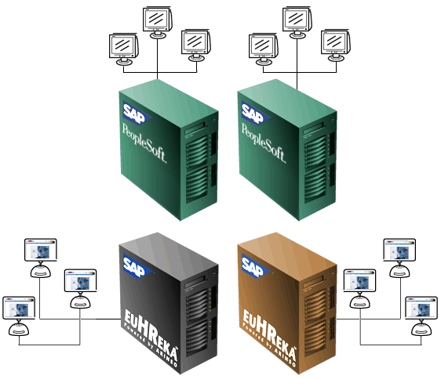
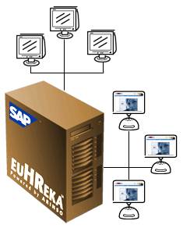

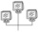
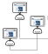
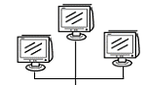
the Customer Landscape Options
the Landscape
Alternative 1:
euHReka 1toN HRIS & Payroll
(multi-customer)
one-to-many HR & payroll platform , supporting both global HR processes & payroll
Alternative 2:
(Existing) master HRIS for global
HR processes linked to euHReka
Alternative 3 :
euHReka 1to1 HRIS & Payroll
(dedicated)
dedicated HR & payroll platform, supporting both global HR processes & payroll
(2.a.) one-to-many payroll platform
(2.b.) dedicated payroll platform
@
1:N
1:1
@
@
1:N
1:1
@
< 15,000-20,000 Employees
> 15,000-20,000 Employees
These 3 scenarios are based on NorthgateArinso’s contract for “BPO Services Powered by SAP”
Legend
euHReka Multi-Client
SAP/Psoft standard interface
euHReka Dedicated
HRIS at Customer
@
euHReka web interface
Notes:
Different combinations of systems.

Slide 27
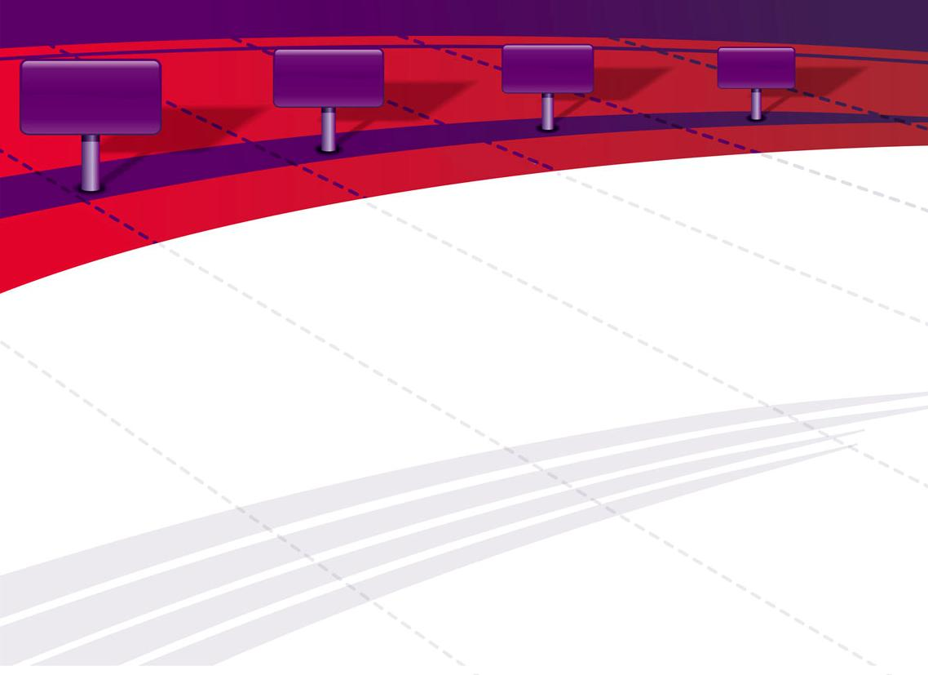


euHReka workspace Roadmap
Pilot:end of May 2009
GA: end of Jul 2009
Pilot:end of
Jul 2009
GA: end of
Oct 2009
Pilot:end of
Oct 2009
GA: end of
Jan 2010
Pilot:end of
Jan 2010
GA: end of
Apr 2010
EFR 2.03
EFR 2.04
EFR 2.05
EFR 2.02
2010
2009
updated Roadmap will be released soon
Notes:
Show the roadmap document in Word and in PPT (high level)
Employeer Settings (not for EoP):
Securex is 32.000 employeers (companies)
Employeers are Master Data
Configuration could not be done in Production but this functionality allows to do it via going to DEV->TEST->PRD
Work Schedules (IT0007)
Company Car Management
euHReka Parameters which allows customer configuration by themselves
Show the Functionality Matrix and the CAB
27

Slide 29








Full HR Process Coverage
Process Coverage
Strategy & Communication
Workforce Administration
Talent Management
Recruitment & Staffing
Analytical Insight
Service Center Management
Enterprise Content Management

Slide 30




euHReka, Full HR process Coverage
Process Coverage
Recruiting & Staffing
- Requisition Management
- Candidate Management
- Candidate Selection
- Contract Management
- Contract Management
Talent Management
- Learning
- Performance Management
- Succession Planing
- Compensation Management
Analytics & Reporting
- KPI’s
- Operational Reporting
- Ad-Hoc Queries
- Service Center Management
Workforce Administration
- Personal data Management
- Time Management
- Payroll Management
- Benefits
Strategy &
Communication
- Organizational Development
- Employee Communication
- Workforce Planning
- Enterprise Content Management
Notes:
See solution Briefings

Slide 31

Process Coverage

Slide 32
Strategy & Communication
Functionalities
Organizational Management
manage organizational structure
manage positions
manage jobs/job families
manage job requirements
manage Cost Center assignments
manage chief positions
manage matrix structures
Who is Who

Slide 33
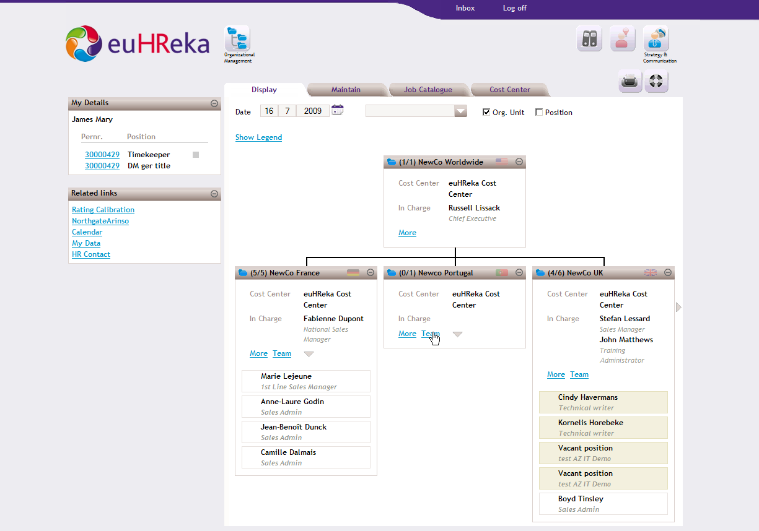
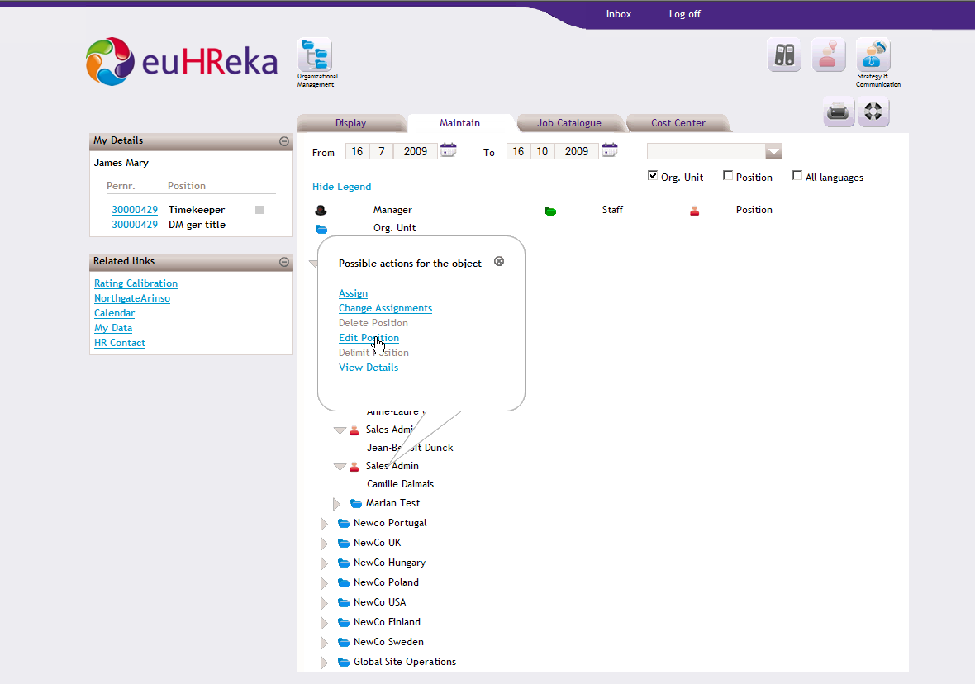
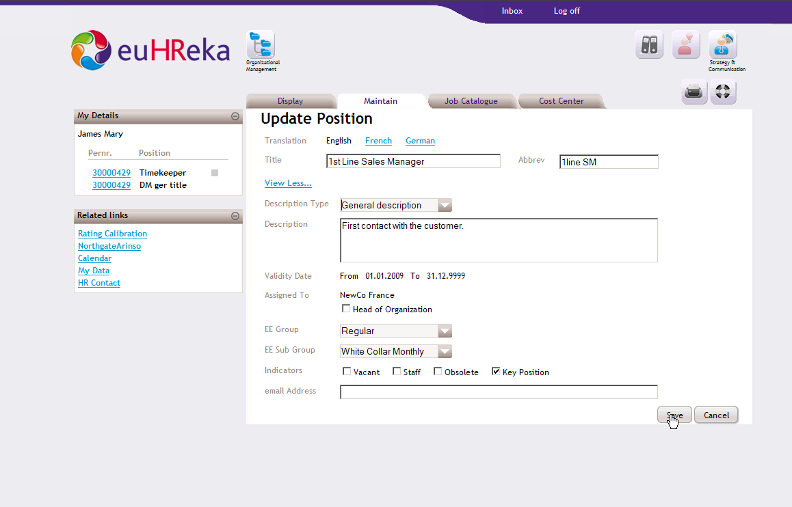
Organizational Management

Slide 34






Workforce Administration
Functionalities
Personal Data
Manage personal Data
Manage contractual Data
Manage Structural Data
Manage Life & work events (PCR’s & PDCR’s)
Fast Data Entry
Mass Data Entry
Reporting
Web-enabled ABAP Reporting
KPI Reporting (BO / ERP Insight)
Salary Data
View Payslips
Manage Pay Data
Manage Life & work events (PCR’s & PDCR’s)
Fast Data Entry
Mass Data Entry
(Payroll / Payroll Provider Inclusion)
Benefits (US & UK)
Enrollment
Manage Dependents
Benefits Statement
Benefits Provider Inclusion
Time Data
Calendar
Quota
Manage abcenses & Attendances
Fast Data Entry
Mass Data Entry
Clocking system Inclusion

Slide 35
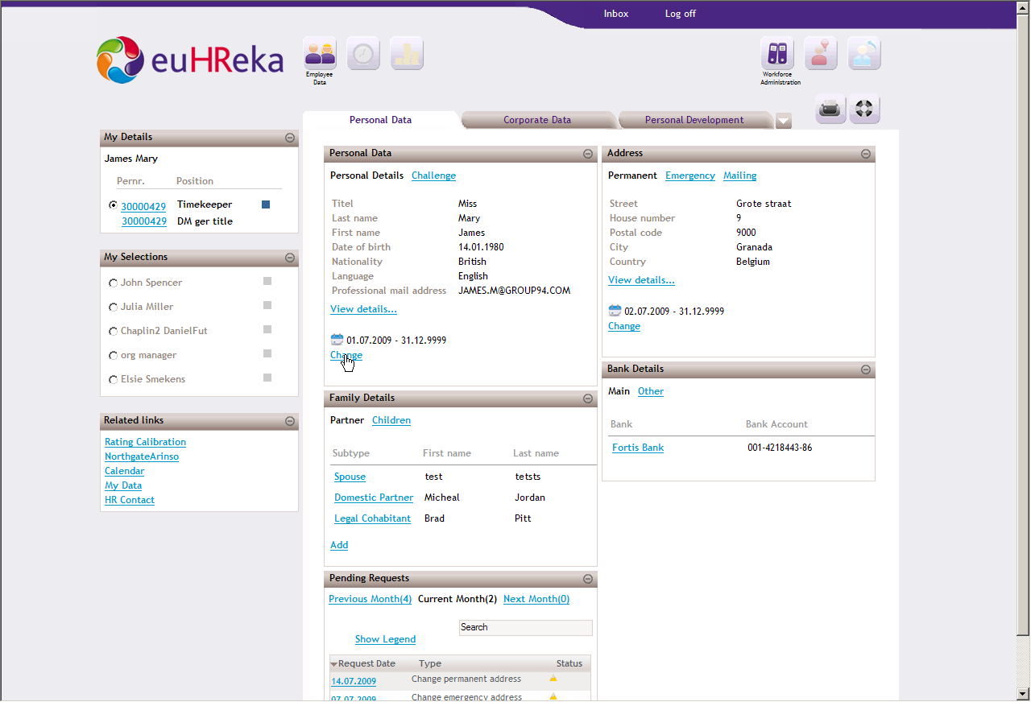
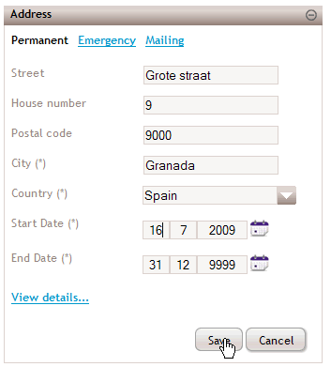
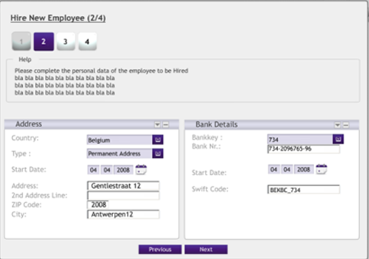
Personal Data

Slide 36
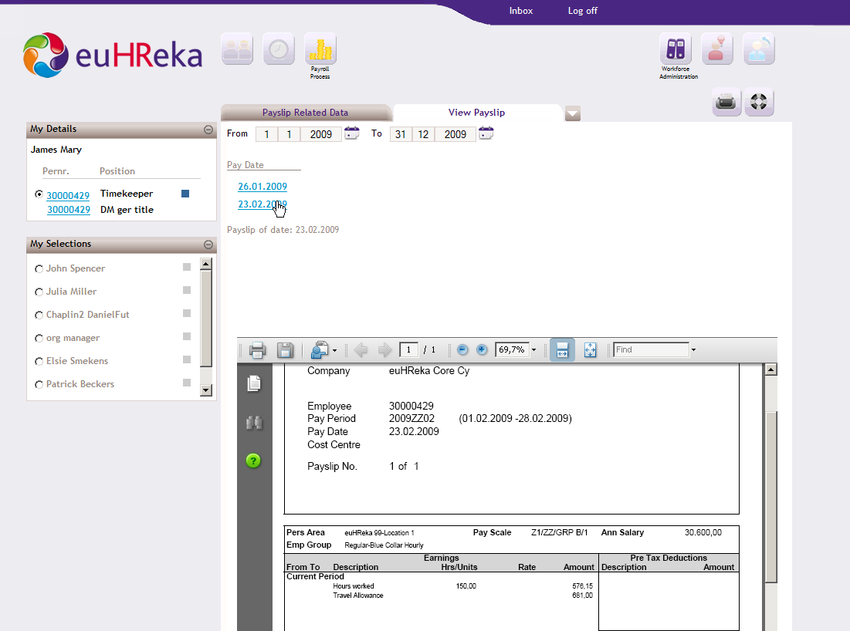
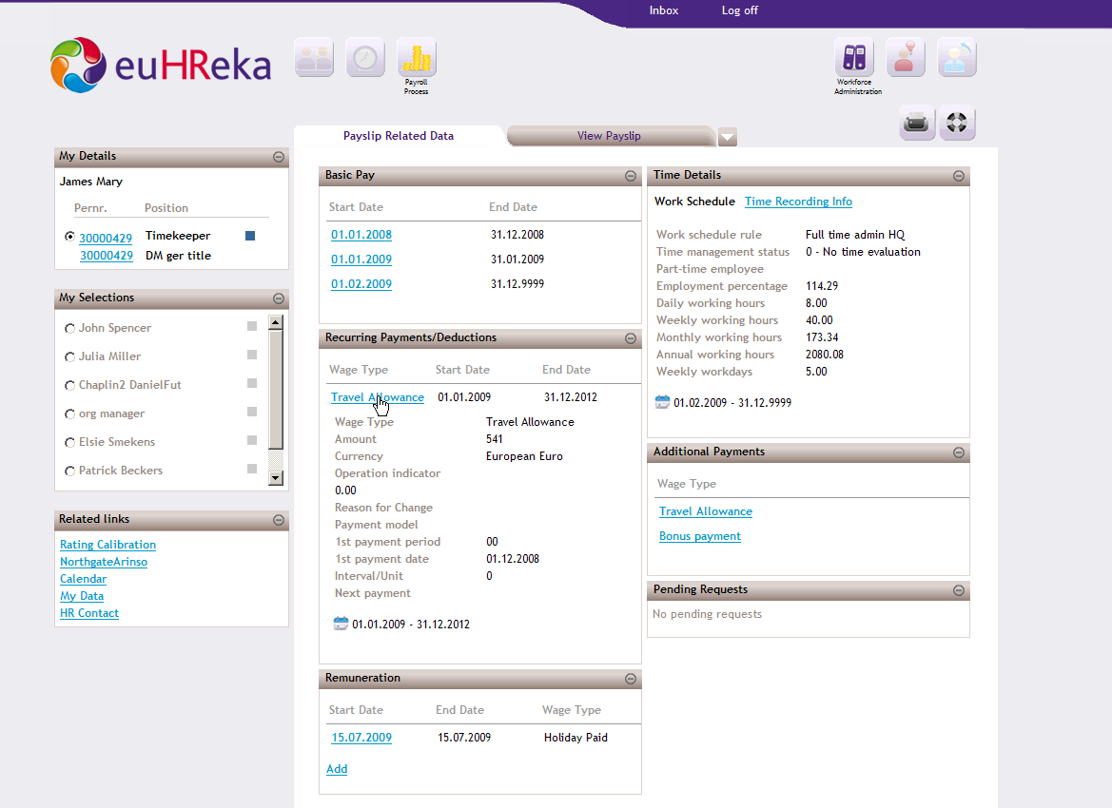
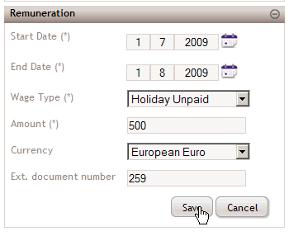
Salary Data

Slide 37
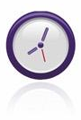
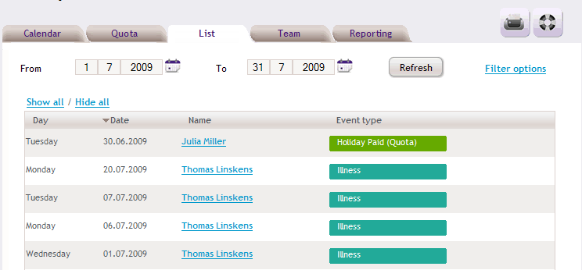
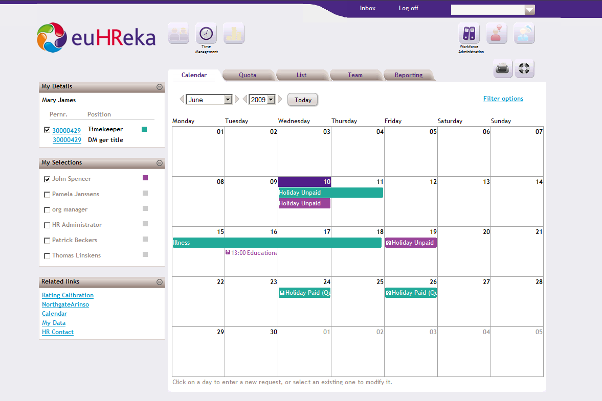
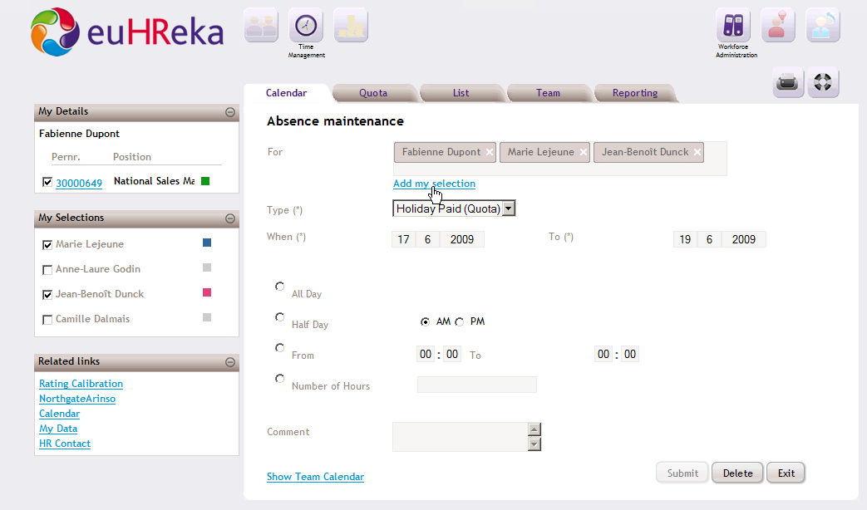
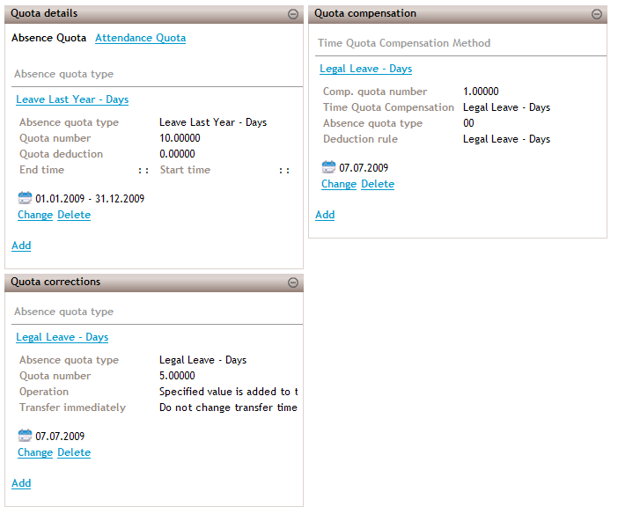
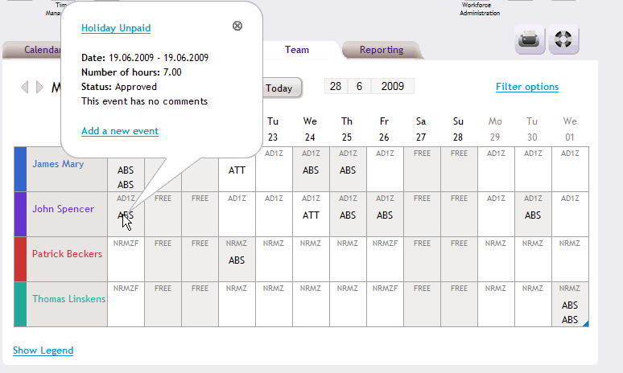
Time Data

Slide 38



Recruitment & Staffing
Functionalities
Requisitions / Applications
View & Manage vacancies & requisitions
View & Manage applications & candidates
View & Manage requirements
View & Manage Publishing channels
Candidates / Talent Pool
View & Manage Applicant Profiles
Personal data
Qualifications
Previous Work Experience
Education
View & Manage Correspondence
View & Manage Assignments
View & Manage Activities
View & Manage Selection & Ranking
Activities & Assignments Calendar
View & Manage tasks
Interviews
Questionnaires
Assessments
Tests
Manage Talent Pool
Talent Search by criteria
Candidate Score / Ranking /Sorting
Candidate Selection
Reporting

Slide 39
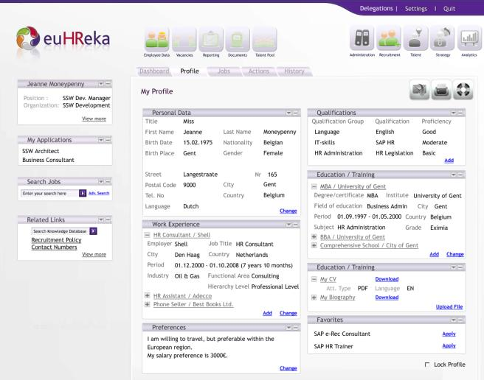
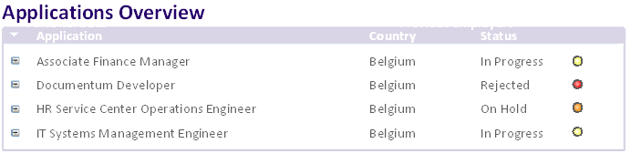
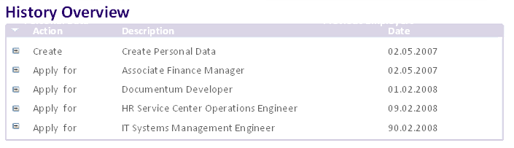
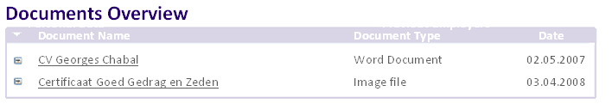
Recruitment User Interface

Slide 40
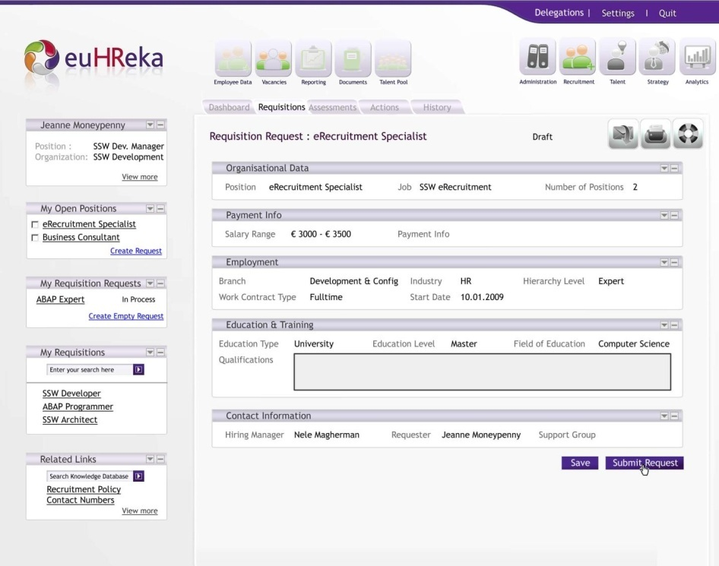

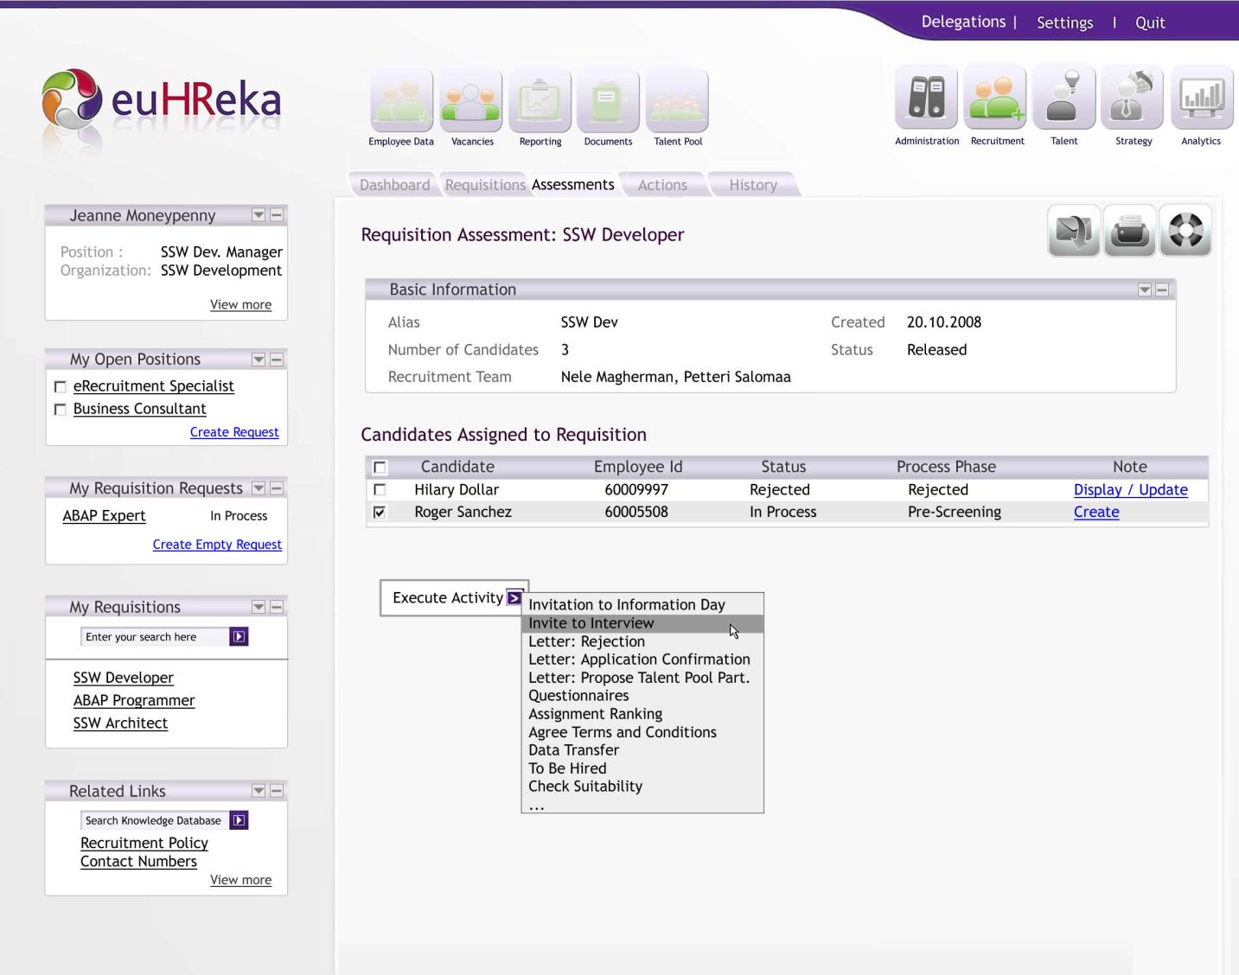
Recruitment User Interface

Slide 41






Talent Management
Functionalities
Learning
Manage Training Catalogue
Manage Pre-booking/ Booking/Cancelations
Manage Training evaluations
Manage Trainee evaluations
Manage Trainer evaluations
Manage Competency Relation
Search training for competence
Link competence to training
Inherit competence
Manage Actions
Performance Management
Manage Objectives
Manage Competencies / competence Catalogue
Manage Development plan
Manage Compensation plan
Manage Career plan
Manage Preferences
Manage Actions
Manage Calibration Performance Scores
Succession Planning
Assign Successors
Assess Internal & External Succession Risks
Manage Development plan
Manage Career plan
Manage Actions
Compensation
Manage Compensation
Manage Performance based pay
Manage Compensation calibration
Reporting
9 Box Grid Reporting
Chart Reporting

Slide 42

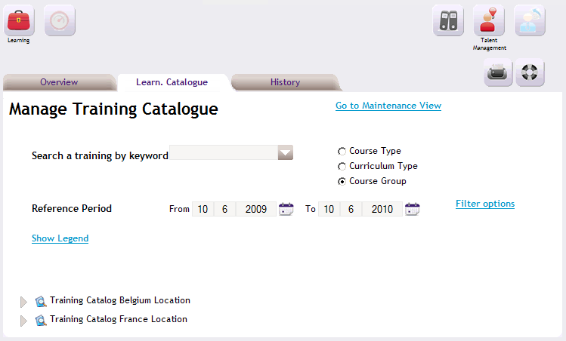
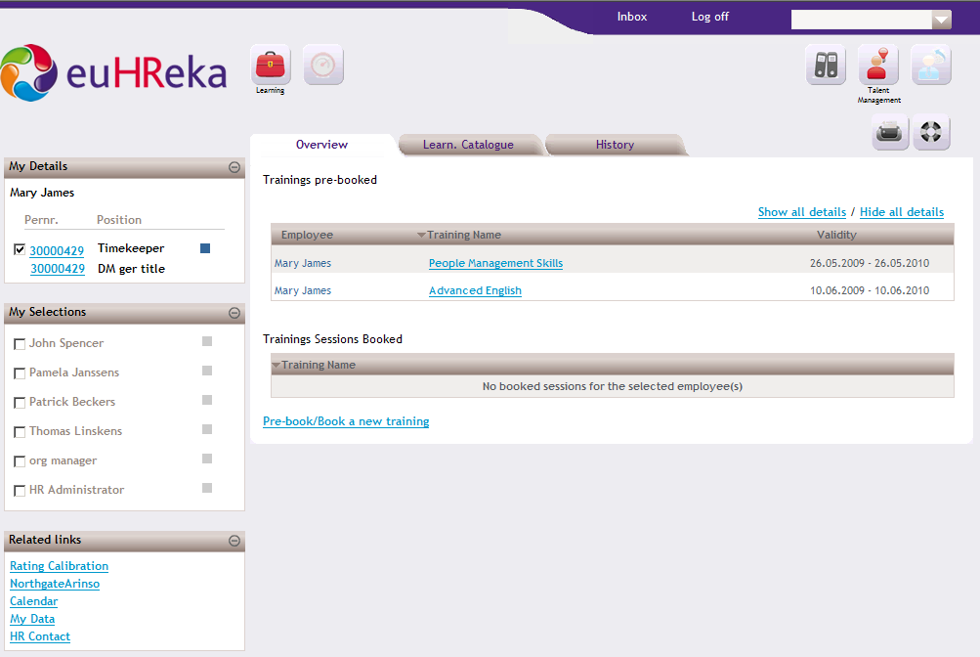
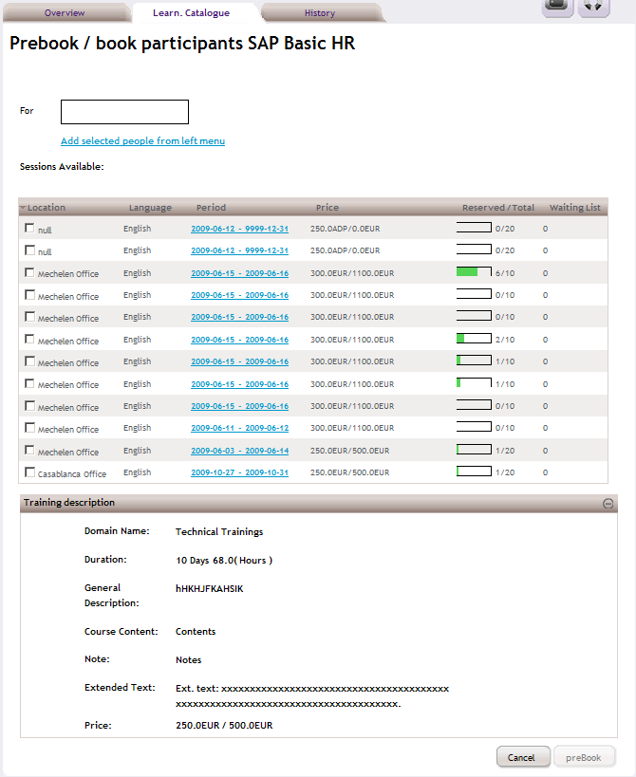
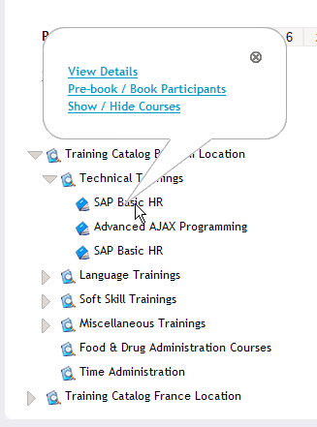
Learning

Slide 43

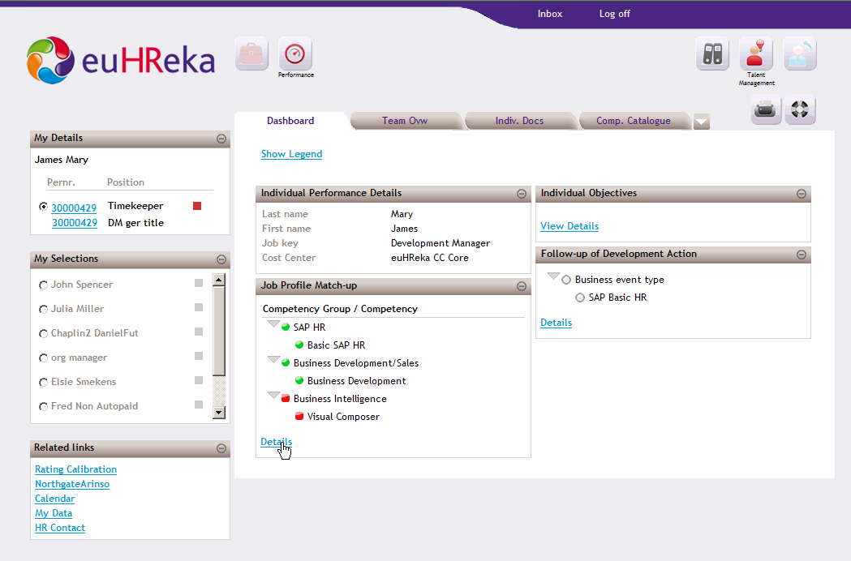
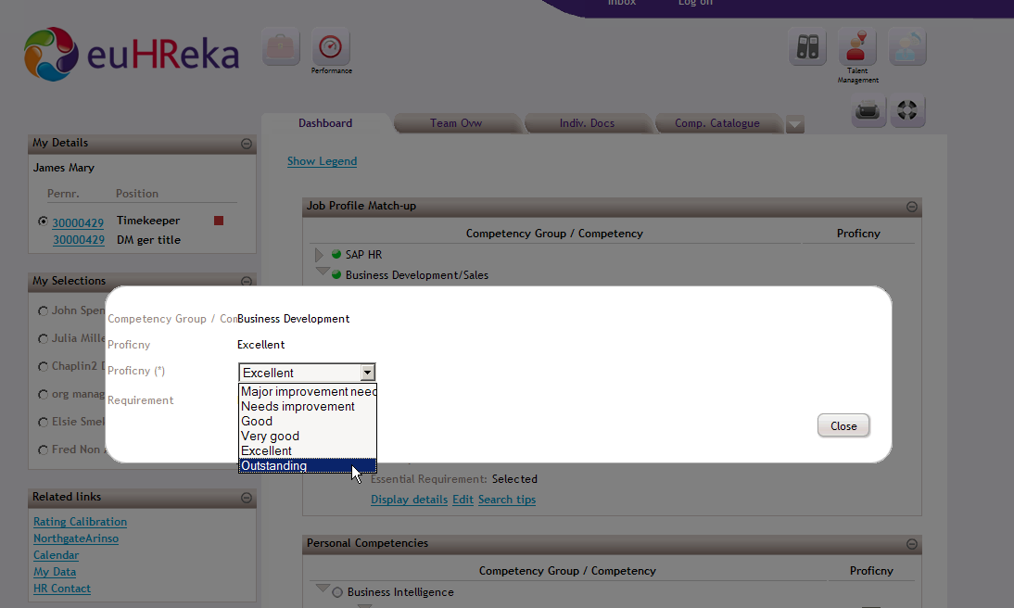
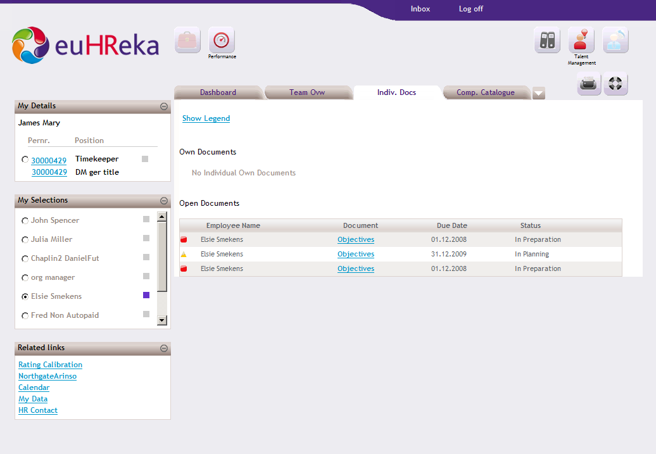
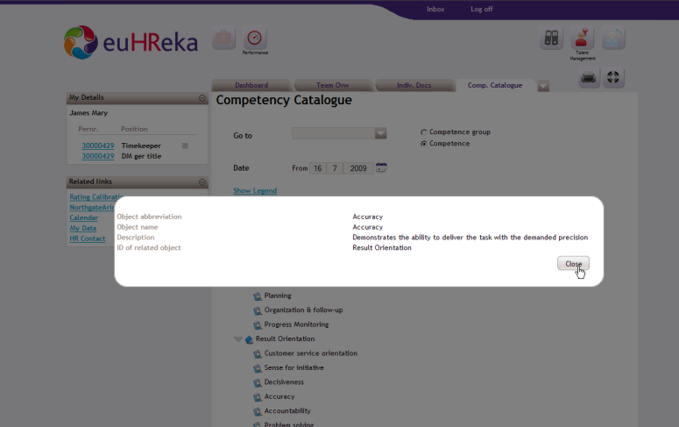
Performance Management
Notes:
5:00:00

Slide 44
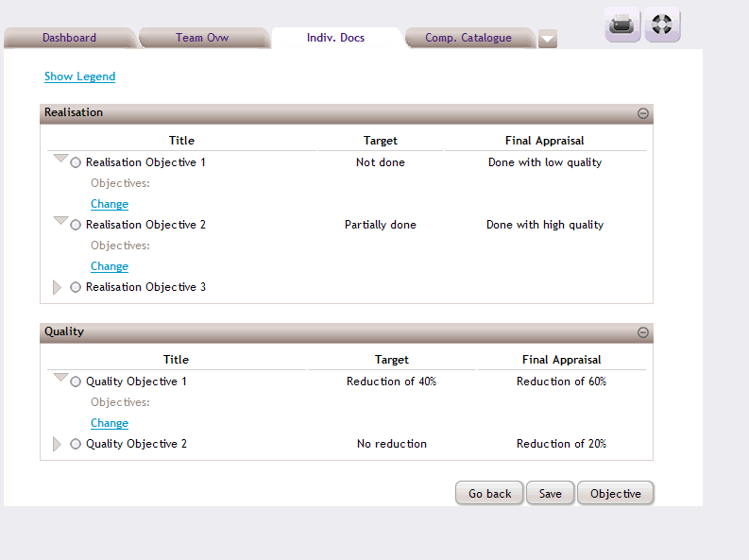
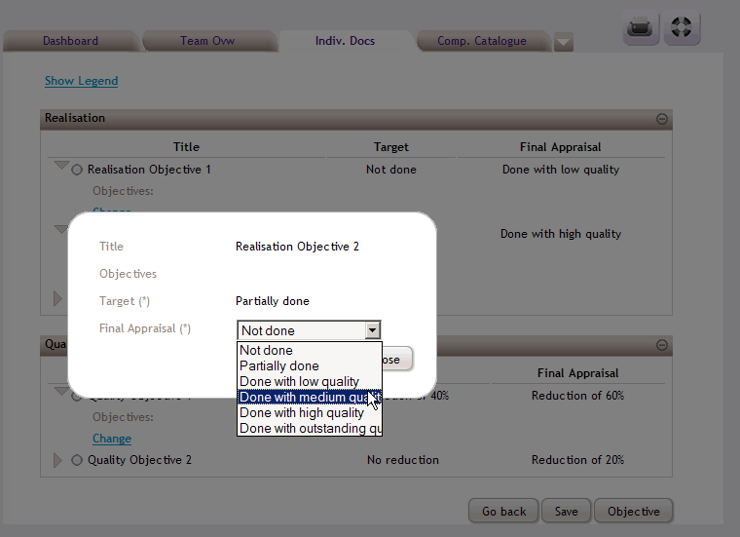
Appraisal Document

Slide 45
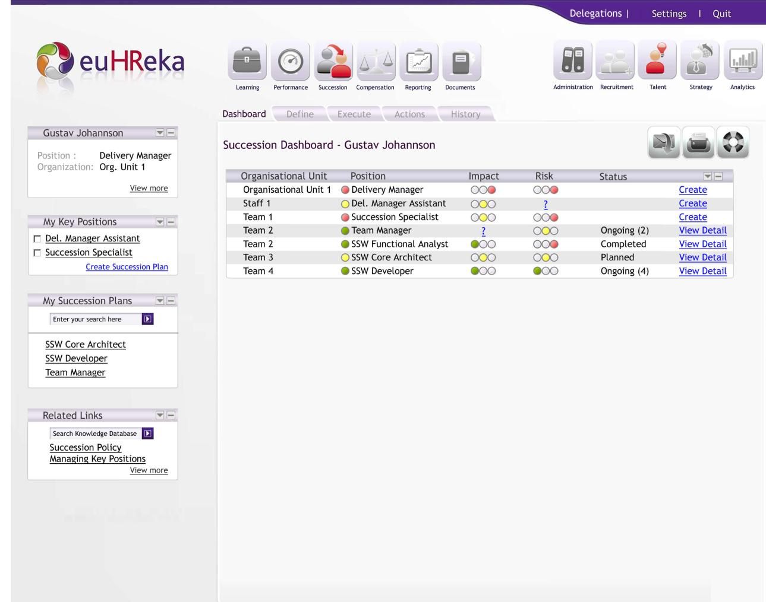
Succession Planning

Slide 46

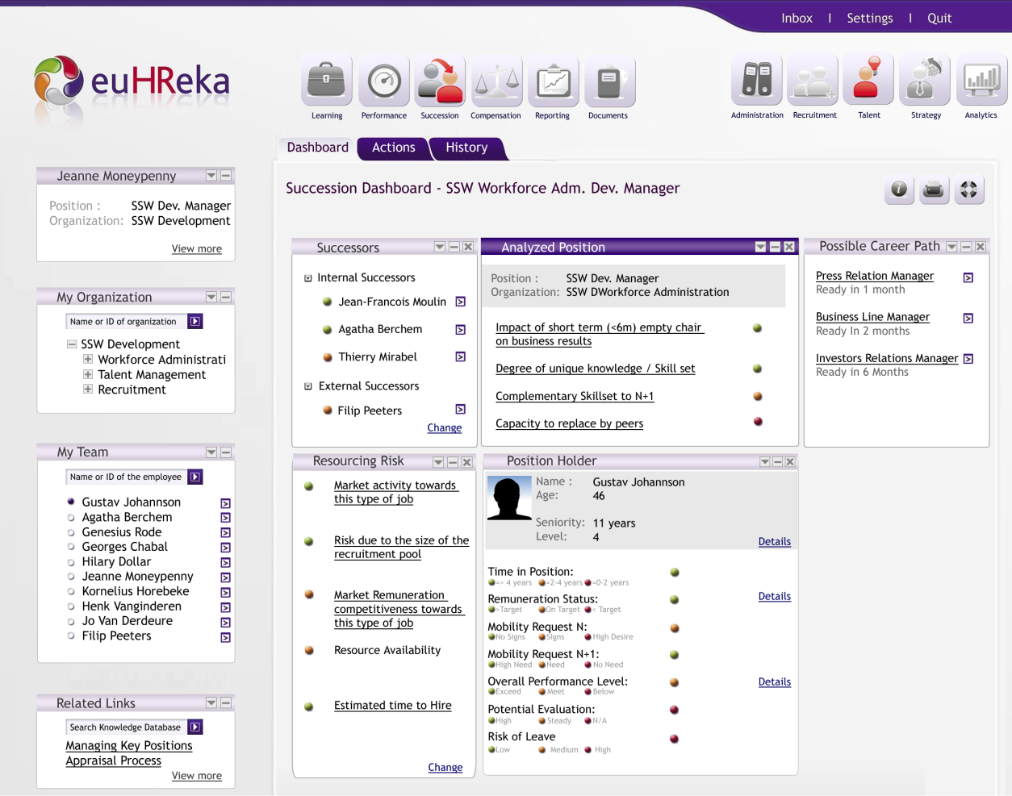
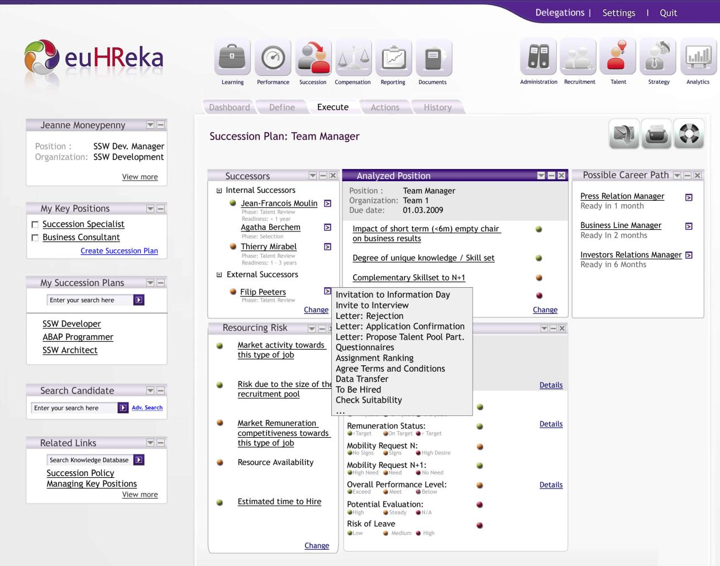
Succession Planning

Slide 47
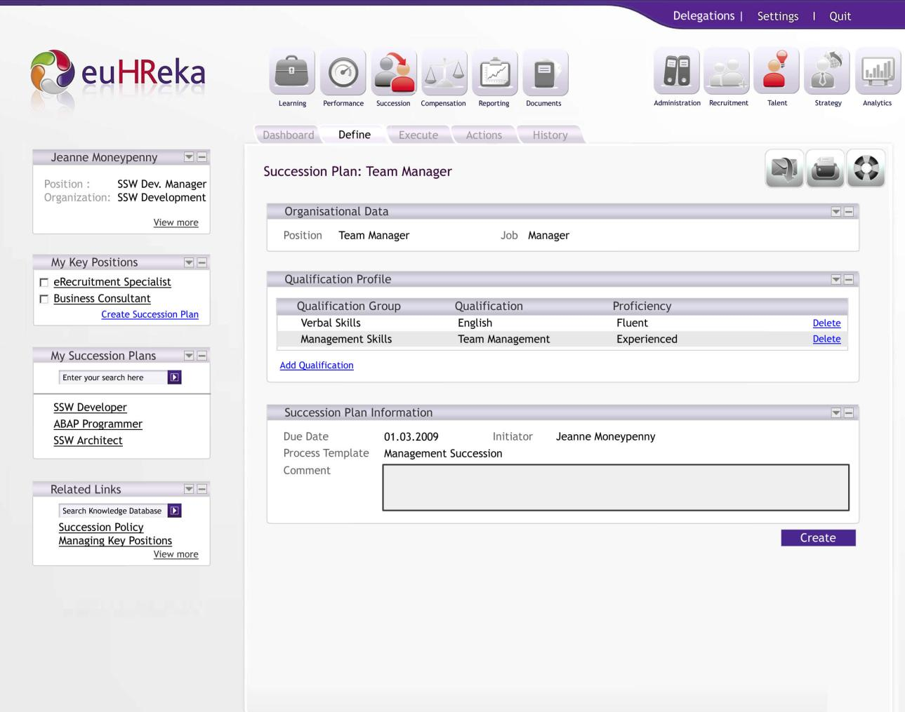
Succession Planning

Slide 48





Command Center
Functionalities
The command center is a unified view on incoming and outgoing data , process & interaction
Employee Interaction Control (Ticket – Gateway)
Phone
Mail
Fax
Paper forms
e-forms
Optional
HRW Gateway
Control & Alerts
Data Coherence Control & Alerts
Pre-synchronization Control & Alerts
Inclusion Framework Monitoring
Incoming Data
Outgoing Data
Synchronization Process
Action Status & control
Approvals
Checks
Continued PCR’s
Etc

Slide 49
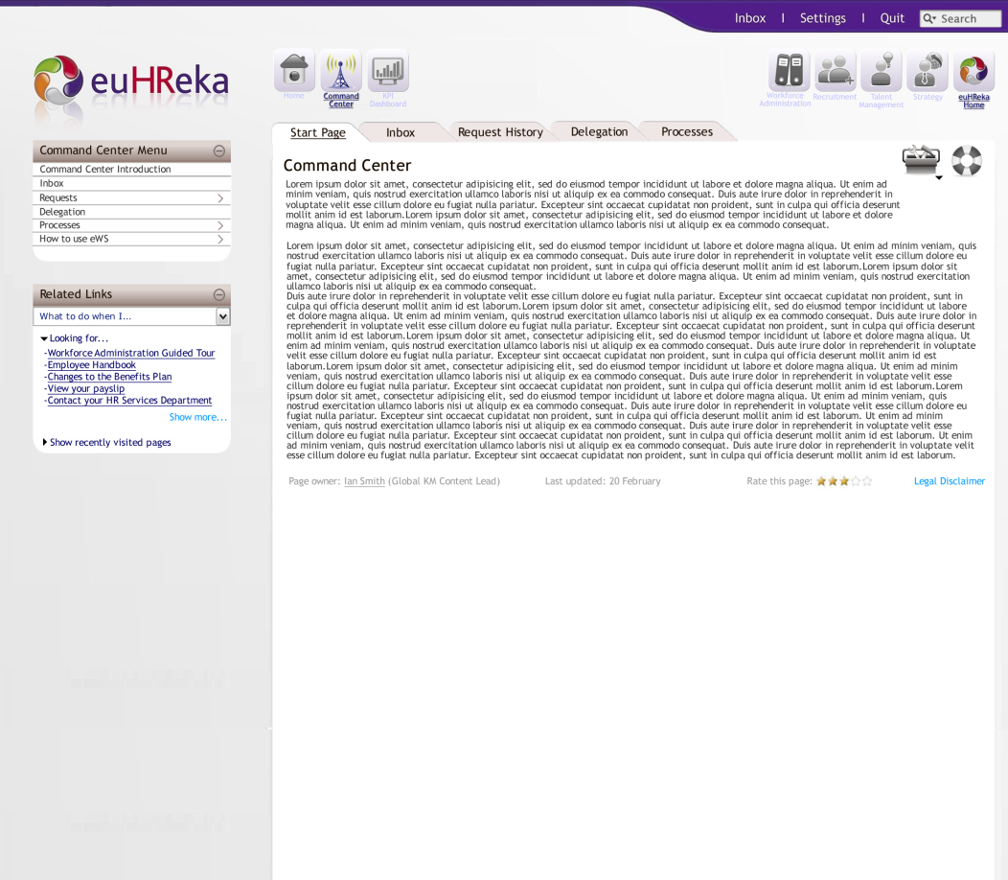
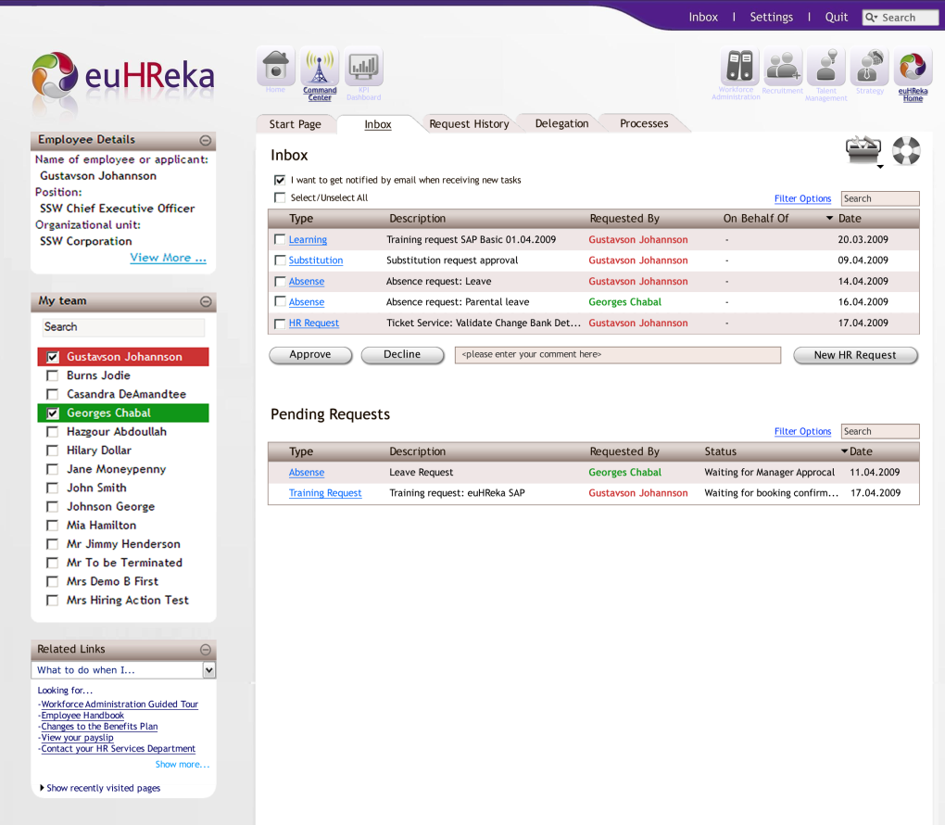
Command Center

Slide 50
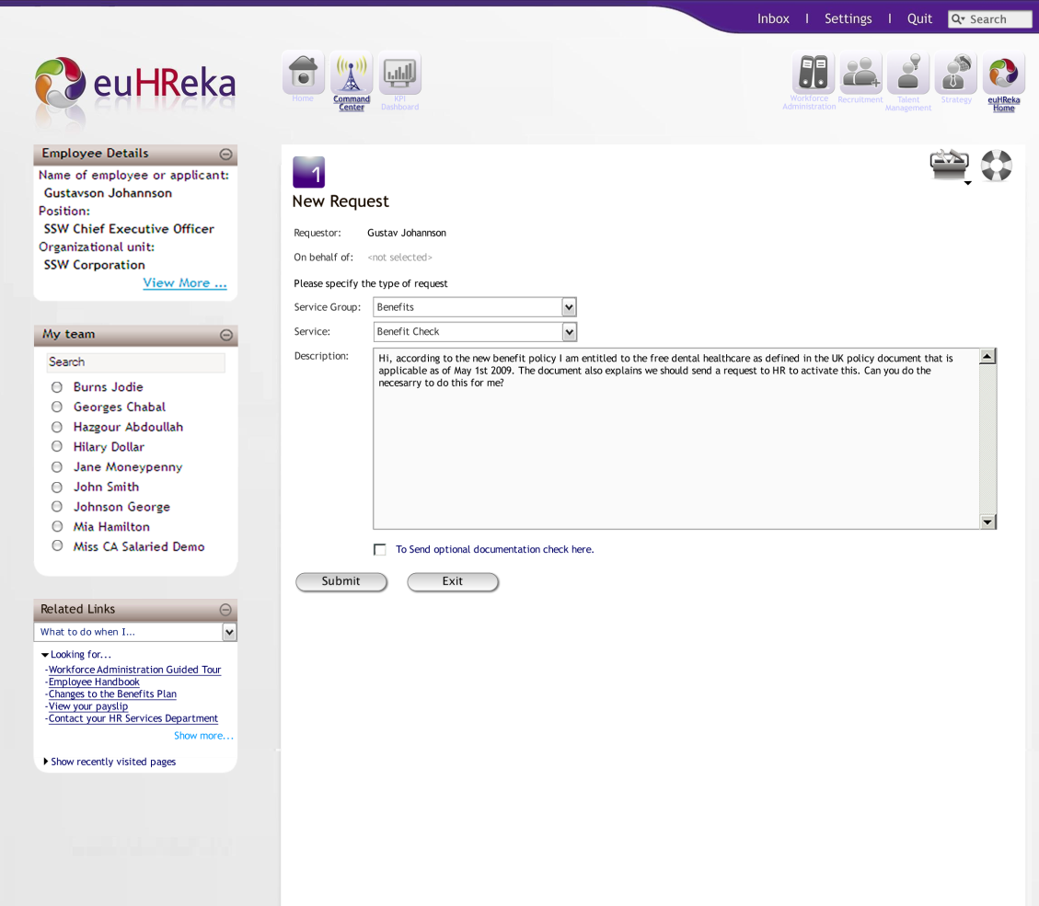
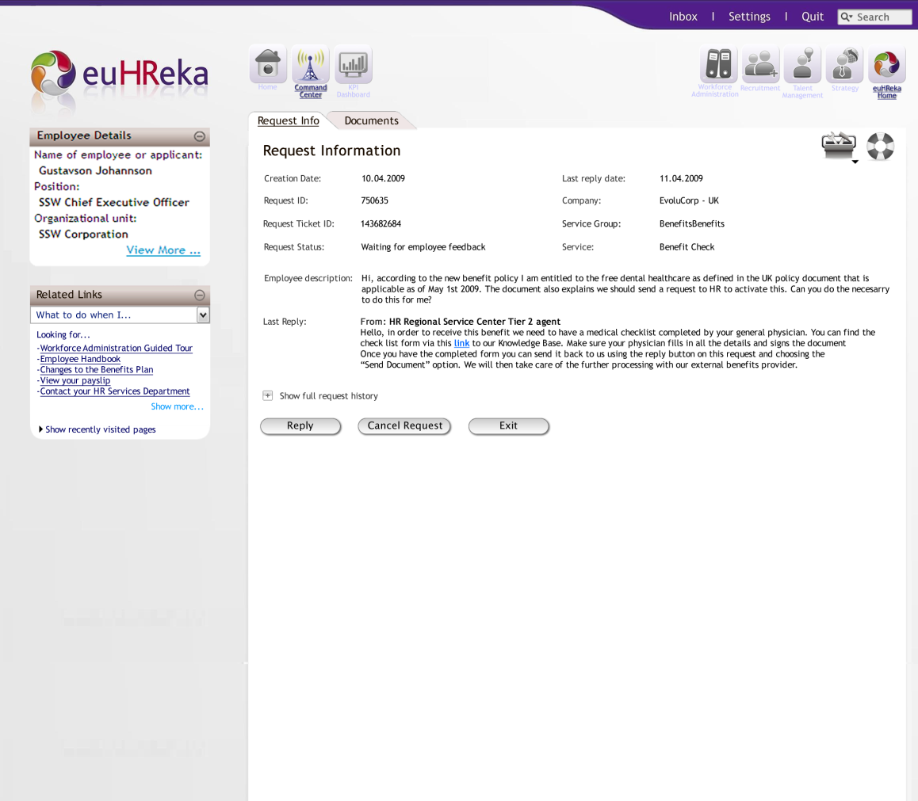

Command Center

Slide 52

Outbound Synchronuous(BAPI) or A-Synchronuous(IDOC)
the Inclusion Framework
euHReka
RBDM-
IDOC
Change
Pointers
euHReka
Back-end
Fieldsets
User exit
IDOC
BAPI
euHReka
Inclusion
Framework
BPM
Start
Close
position
Vacancy
Publish
Verify and
Approve
Post
END
P.I.
PI
Adapter
Mapping
Adapter
File/XML/IDOC
3rd Party Providers
Notes:
Standarized Interface
Ashyncronous Idocs
Shyncrononous BAPIS
Adapters of formats
Conversion

Slide 53
Inbound Synchronuous(BAPI) or A-Synchronuous(IDOC)
the Inclusion Framework
euHReka
euHReka
Back-end
Fieldsets
Idoc Processing
Or
BAPI Handling
euHReka
Inclusion
Framework
BPM
End
Update Candidates
Start
PI
Adapter
Mapping
Adapter
File/XML/IDOC
3rd Party Providers

Slide 54
3rd Party Inclusion example: Job board Inclusion
the Inclusion Framework
1 user experience
Fully integrated
True Vendor Management
Same SLA Approach
Integrated Delivery model
*Inclusion = Beyond Integration
term used in Special Education

Slide 55
Notes:
Check Intranet with PMO

Slide 56



Global On Boarding approach
On-Boarding Approach
Global Program Set-up & Preparation
Global realization
Global Template & Planning
Global Maintenance & Support
Global On Boarding Approach
Global Realization
Pilot Country Rollout
Global Realization
Final Template & Core System
Global Realization
Roll-out all countries (in waves)
Country Rollouts
Prepare
Fit-Gap
Test
Realize
Transition
Go-Live
Support
Prepare
Fit-Gap
Test
Realize
Transition
Go-Live
Support
Prepare
Fit-Gap
Test
Realize
Transition
Go-Live
Support
Notes:
Global Stream
The program is managed globally.
Global Template sets the global principles driving the overall implementation.
Setting global codes and values
Needs the agreement of the customer at global level. Requires global decisions
Global realization
Impelement all global mechanisms (Personnel structure, OM, values, actions, processess, etc,..)
Takes a significant country as a pilot (Complex, average, easy,..)
Manage the roll-out plans.
Local Streams
Subject to global decisions
Plans may vary as world wide projects take long implementation times
Are transitioned at different times and speeds.

Slide 57

The BOX
The BOX
Notes:
Solution Briefs: 1 page of description
Solution Details:
1 per release
Processes
Replaces the BBP
InfoSpace
Authorizations are link to your job
Project Management Guide
Doing Project
Based on PMBoK
All the structure is pre-populated to your project
Fit-Gap Questionnaires are still under country specific folders
Show Functional Design
BOX
Solution Briefings
Solution Details
Solution Processes: L1 to L3 (4 and % are in operations)
Conference Room Pilot Documents
Configuration Options are represented
Questionnaires
Linked to the CRPD
All under the Box but some of them under PMO
Standard Processes
Delvery Excelence Net = Best Practices Processes
Go to Talent Management

Slide 58

Questions
Q&A

